Slide 1
MIPS Simulator
By: Karsten Salinas
Brenden Burke

Slide 2
Overview
Runs on C++
128 bytes of Registers
4kb of Memory
Data hazard preventions
3 Debug modes

Slide 3
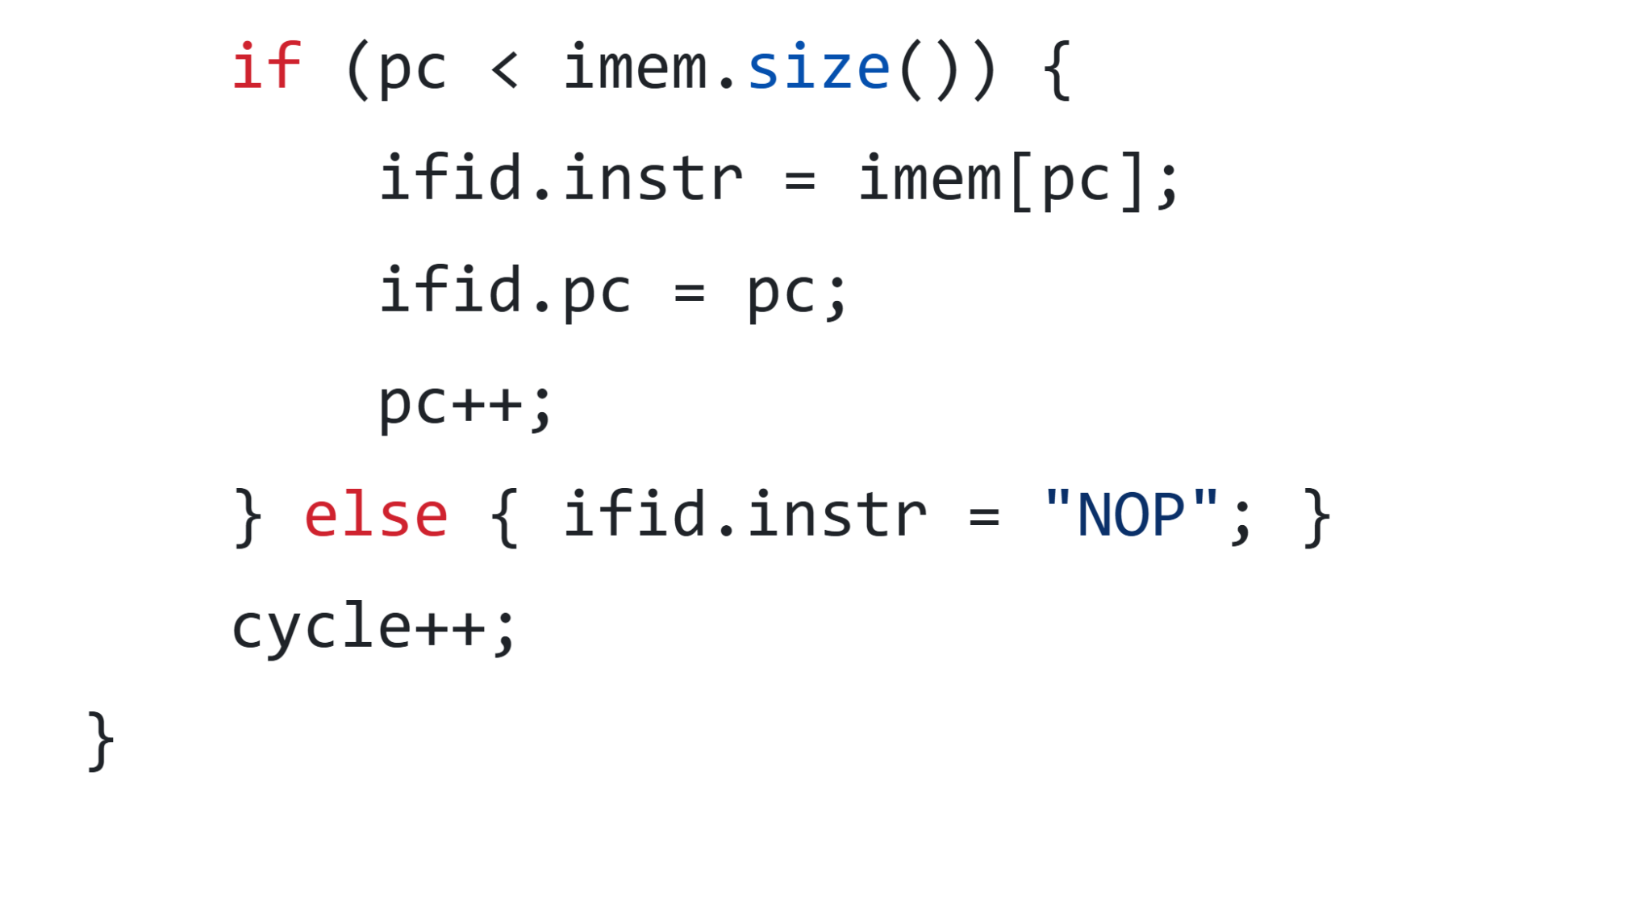
Instruction Fetch
Checks to see if there are more instructions
Loads it into pipeline

Slide 4
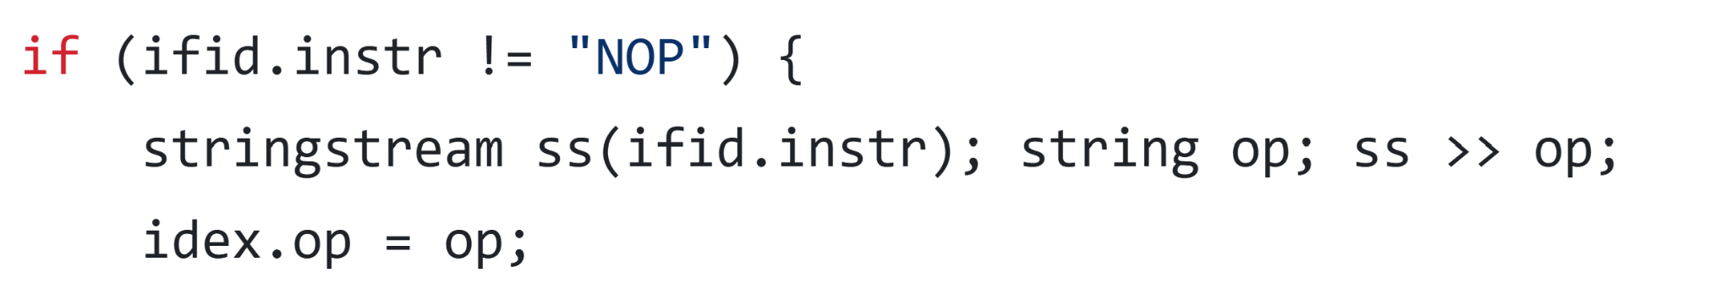
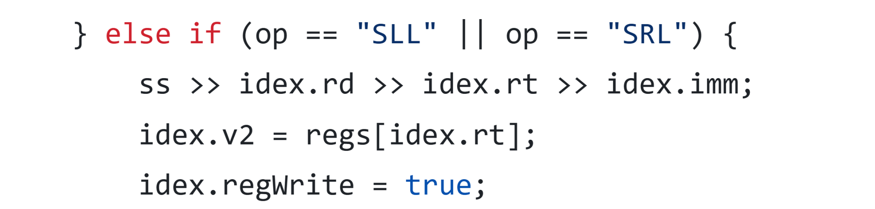
Instruction Decode
Reads the instruction and decodes it into parts
Pipelines the data from the instruction

Slide 5
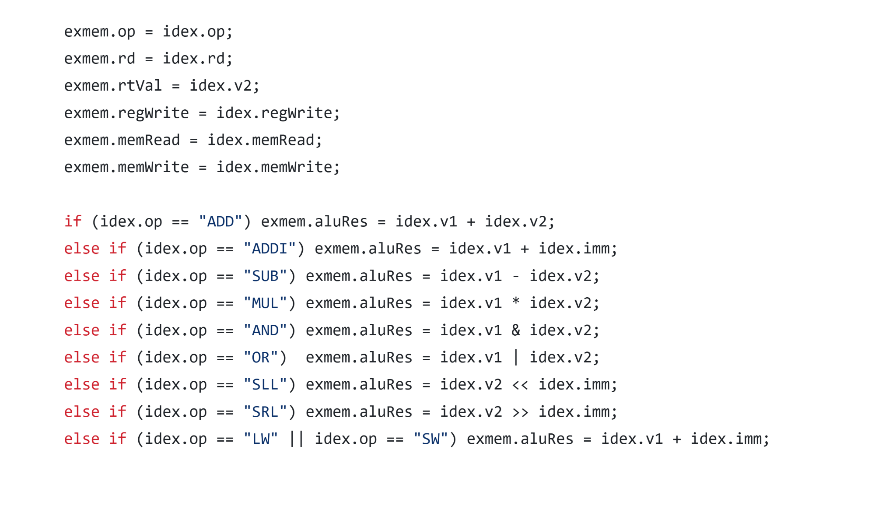
Execute
Passes on the values to the pipeline
Performs the operation based on the OP code

Slide 6
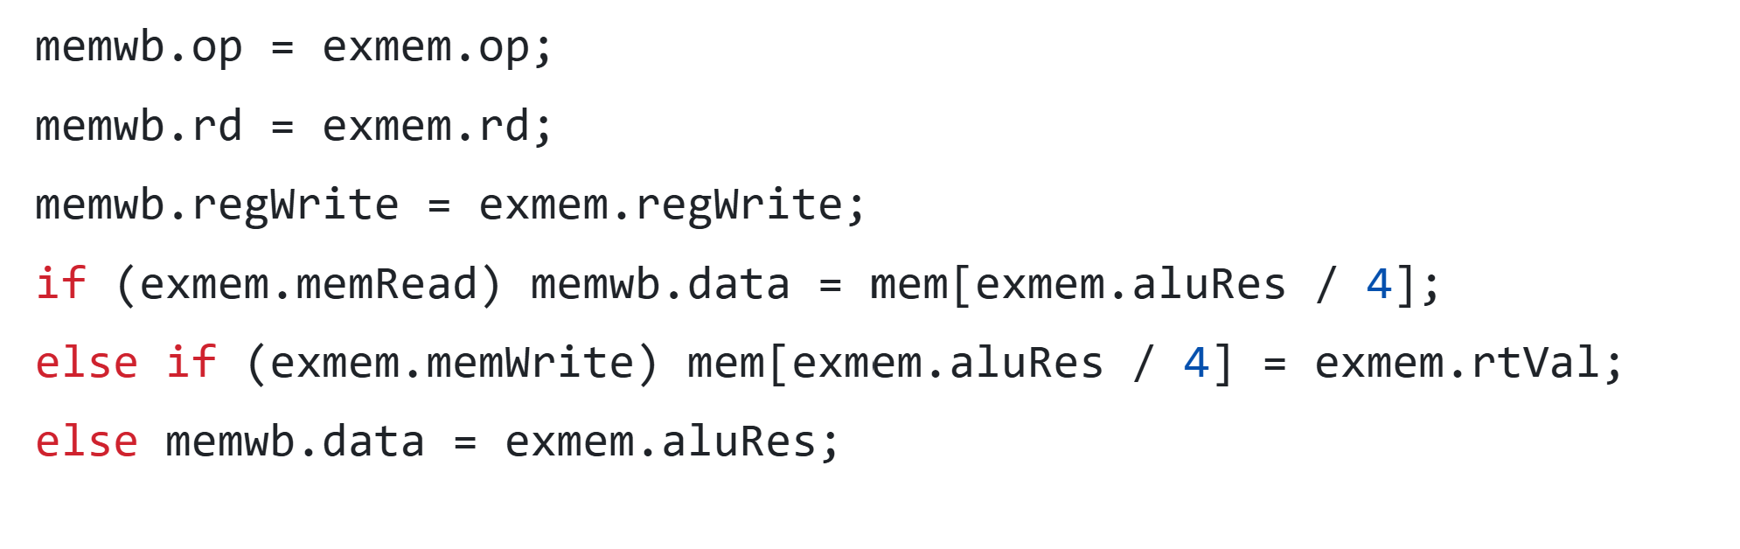
Memory
Pipelines data…
Divides ALU Result by four to go between word and array addressing

Slide 7
Write Back
Writes back to registers if that is the option
Keeps Register 0 consistency

Slide 8
Compilation
Compilation: g++ mips.cpp -o {executable_name}
Run: ./{executable_name} {assem_file} [debug]
assem_file: Any valid MIPS file
debug: Level of debug (Default 0)
0: No debug
1: Prints state registers after every cycle
2: Stops and waits for enter keys after every cycle

